Slide 1

MapReduce Part - 3
By : Dr.Rashmi L Malghan & Ms. Shavantrevva S Bilakeri

Slide 2

AGENDA

Slide 3
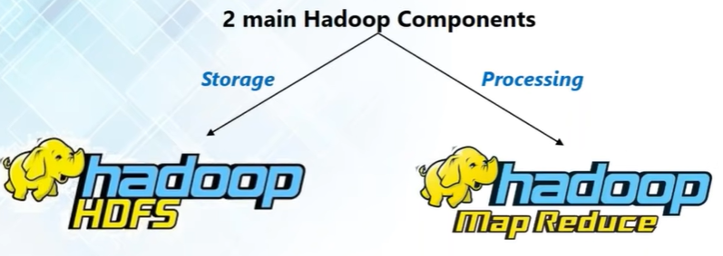
Hadoop Main Components:

Slide 4
Comparison: Convention Vs. MapReduce
MapReduce Approach
Distributed processing across a cluster.
Scalable for large datasets.
Handles parallel processing efficiently.
Tackles the challenges of big data.
Conventional Approach
Single-machine processing.
Suitable for small datasets.
Limited scalability.
May become a bottleneck for big data.

Slide 5
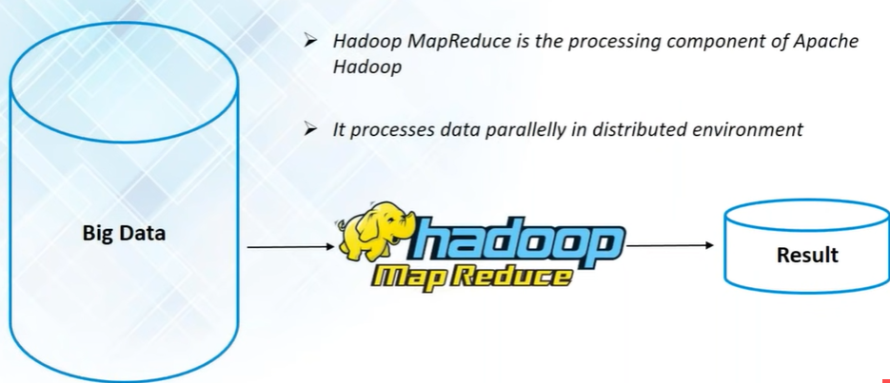
MapReduce:

Slide 6
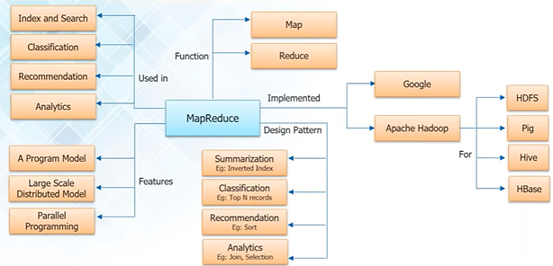
MapReduce - Nutshell

Slide 7
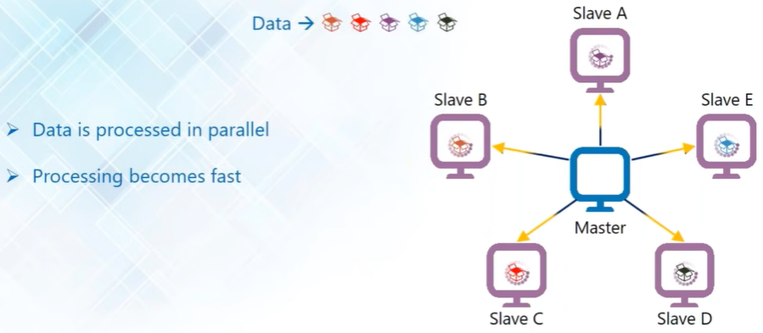
Advantage 1: Parallel Processing
In Hadoop data gets divided in to small chunks called as HDFS blocks.
Scalability
Fault Tolerance
Flexibility
Efficient Resource Utilization

Slide 8
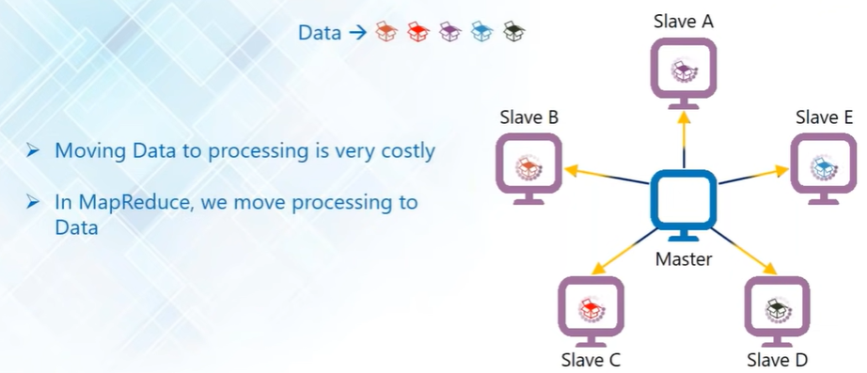
Advantage 2: Data Locality
Processing – Master sends the logic to salves that require for its job processing.
Smaller chunk of data is getting processed in multiple locations in parallel.
It saves “time” & “network bandwidth”- required to move/transfer large amount of data from one point/location to another.
Results will be sent back to master machines and sent to client machine
Data Locality - MapReduce is processing at “Location” where data is stored rather bringing data to “centralised server”
Client Sends/submits data – To Resource Manager decides – Data usually resides on “Nearest Data Node” to reduce the network bandwidth.
Master = Name Node – In Hdfs [Storage] , Master – Consideration -resources manager - Processing

Slide 9
MapReduce: Phases and Deamons
MapReduce Framework
Phases:
Map(): Converts input into Key Value pair
Reduce(): Combines output of mappers and produces a reduced result set.
Daemons:
JobTracker: Master schedules task
TaskTracker: Slave executes task

Slide 10
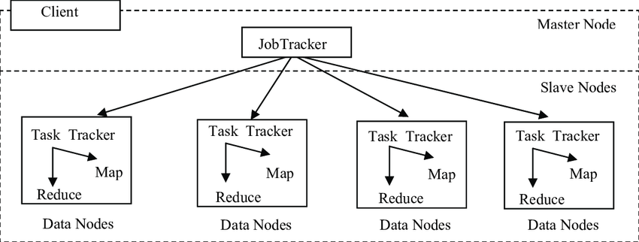
JobTracker and TaskTracker Interaction

Slide 11
MapReduce Programming Workflow
Computing Task
JobTracker
Map Tasks
Reduce Tasks
Map Task
TaskTracker1
Map Task
TaskTracker2
Final Output
Data Block1
Data Block2
Map Output1
Map Output2

Slide 12
Phases in Map and Reduce Tasks
Map Phases
Record Reader
Mapper
Combiner
Partitioner
Reduce Phases
Shuffle
Sort
Reducer
Output Format

Slide 13
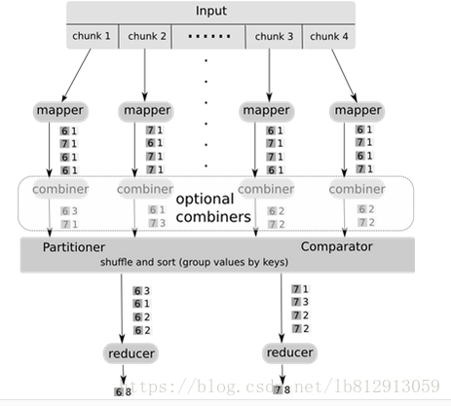
Chores of Mapper, Combiner,
Partitioner, and Reducer

Slide 14
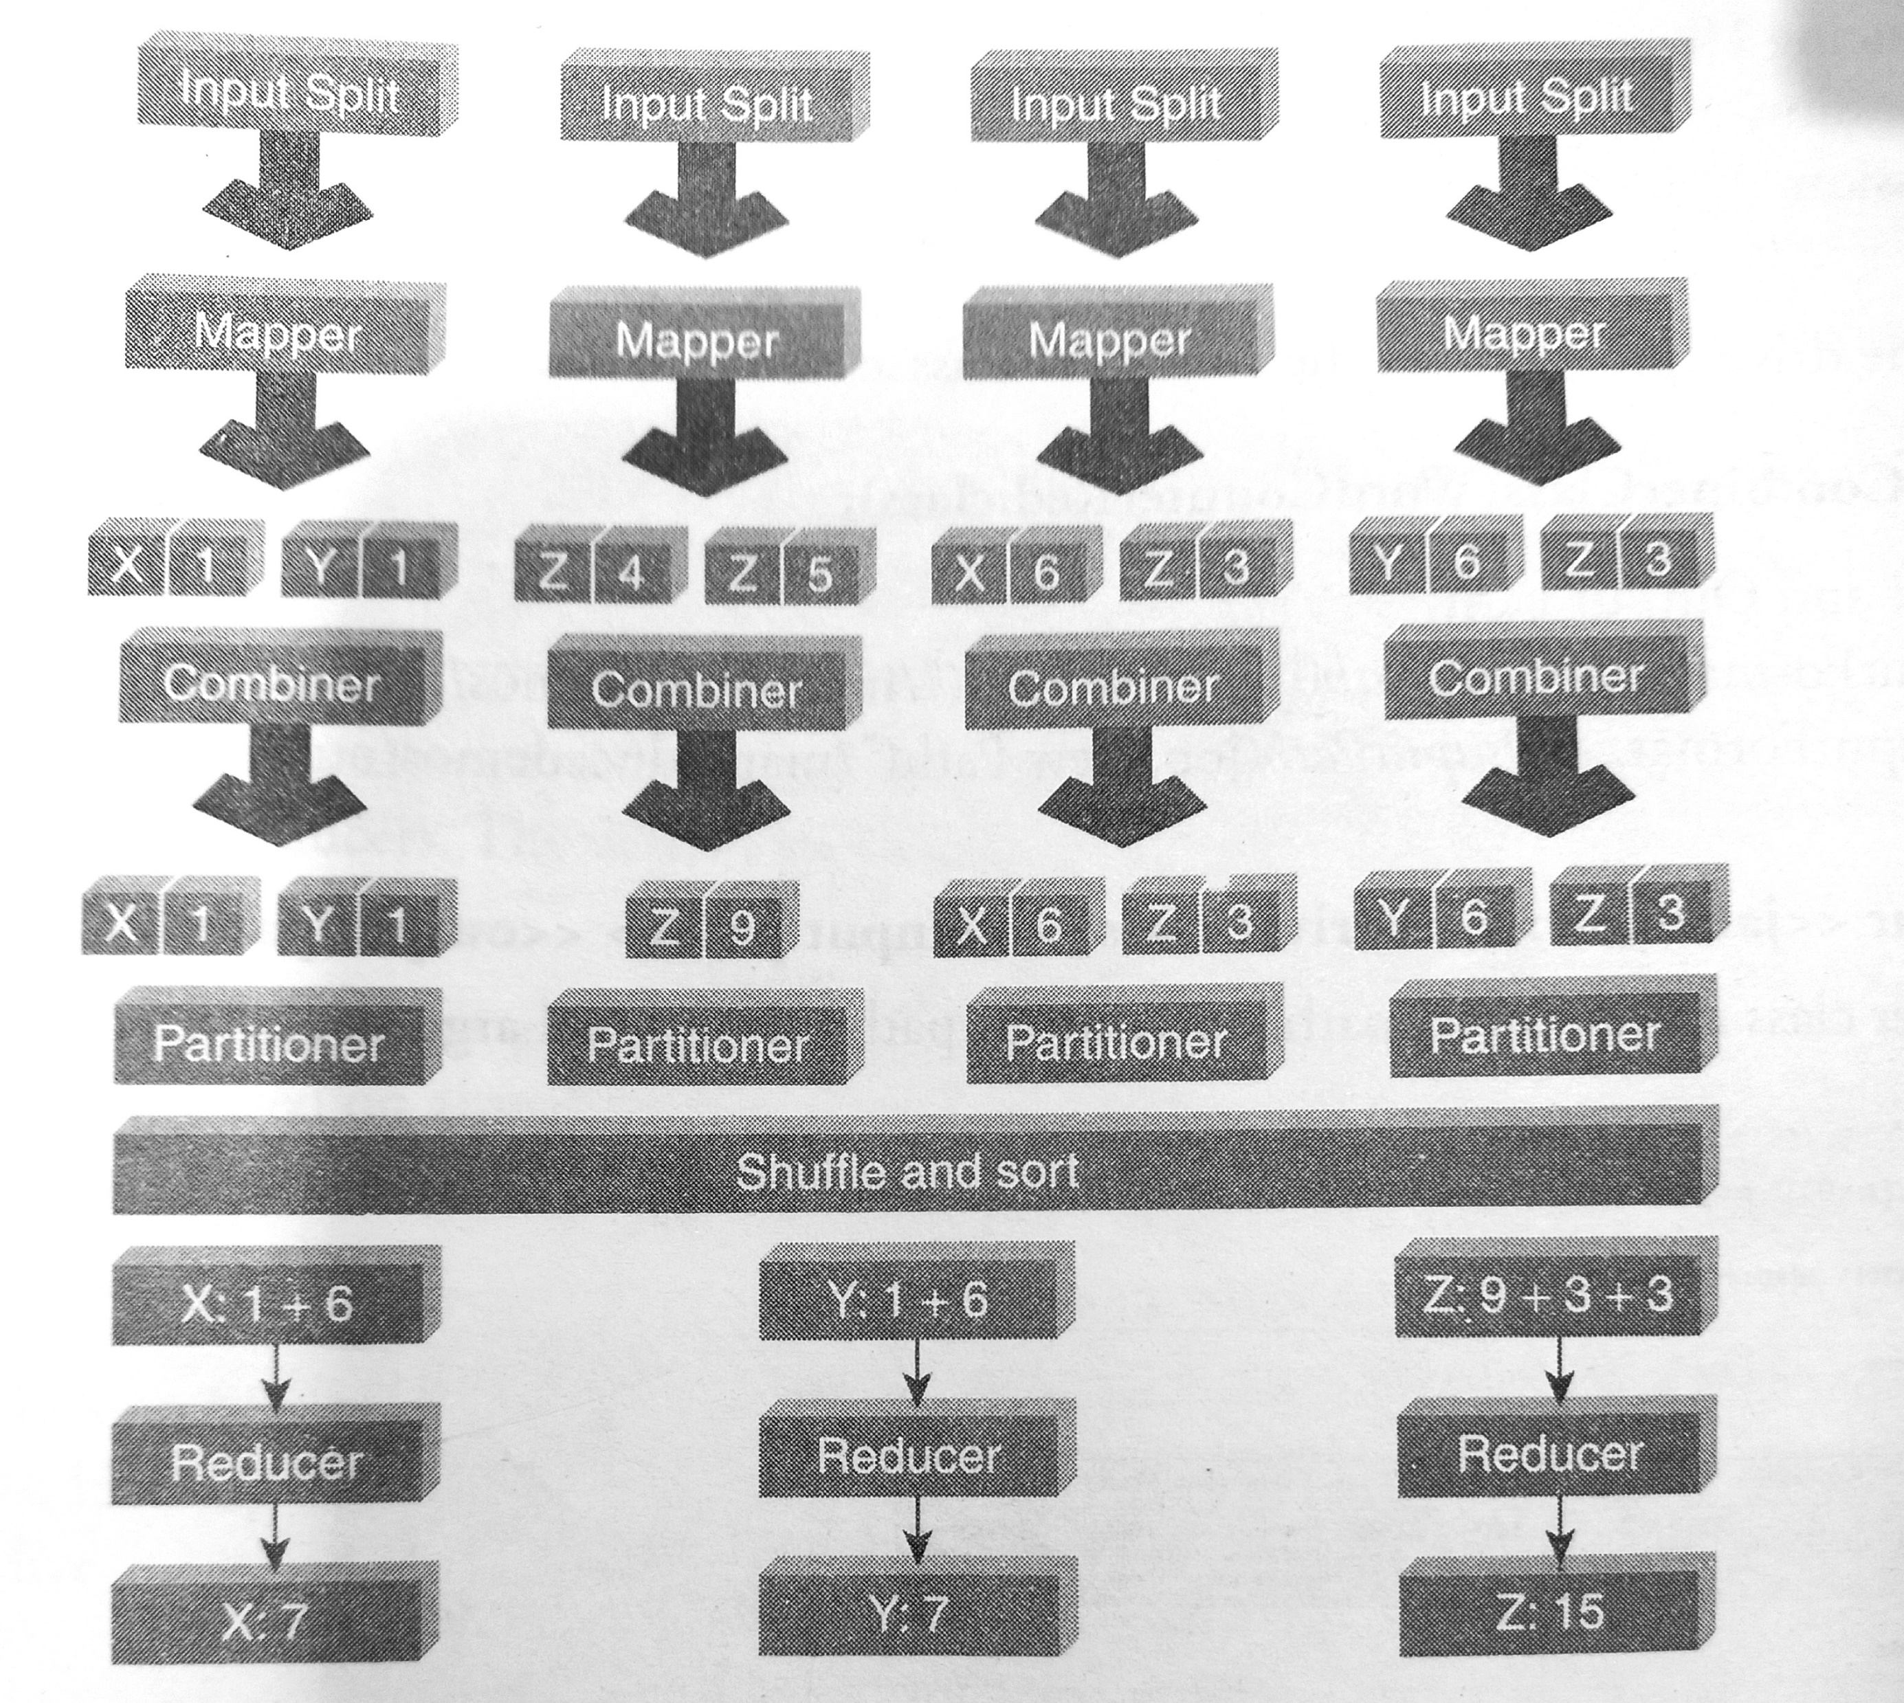
Chores of Mapper, Combiner,
Partitioner, and Reducer

Slide 15
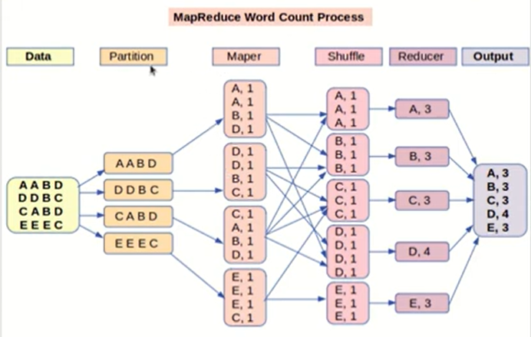
MapReduce: Word count problem

Slide 16
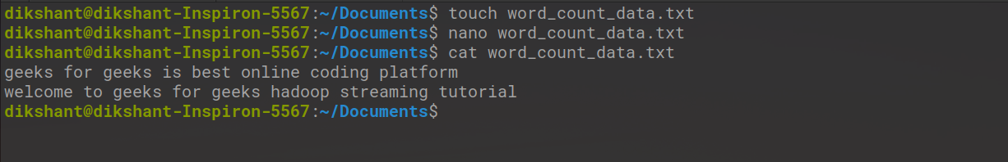
Word Count Program using MapReduce
Step 1: Create a file with the name word_count_data.txt and add some data to it
Step 2: Create a mapper.py file that implements the mapper logic.

Slide 17
#!/usr/bin/env python
# import sys because we need to read and write data to STDIN and STDOUT
import sys
# reading entire line from STDIN (standard input)
for line in sys.stdin:
# to remove leading and trailing whitespace
line = line.strip()
# split the line into words
words = line.split()
# we are looping over the words array and printing the word
# with the count of 1 to the STDOUT
for word in words:
# write the results to STDOUT (standard output);
# what we output here will be the input for the
# Reduce step, i.e. the input for reducer.py
print '%s\t%s' % (word, 1)
Mapper.py
#! is known as shebang and used for interpreting the script.

Slide 18
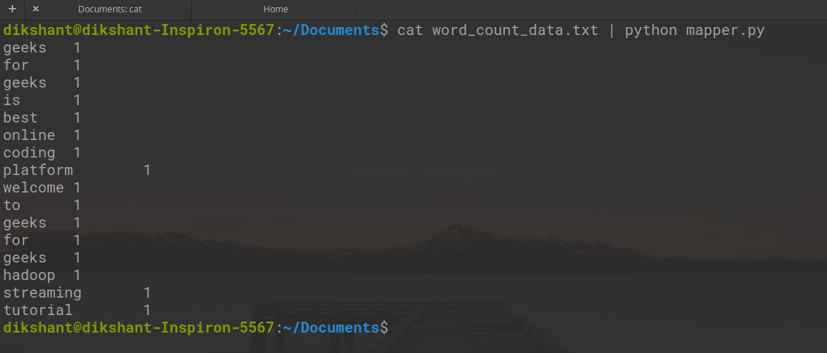
Test mapper.py locally
cat word_count_data.txt | python mapper.py

Slide 19
Step 3: Create a reducer.py file that implements the reducer logic.

Slide 20
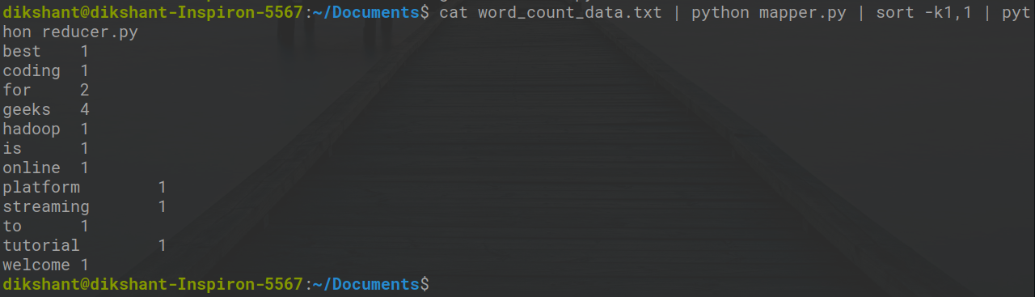
Test mapper and reduce
cat word_count_data.txt | python mapper.py | sort | python reducer.py

Slide 22
Step 4: Now let’s start all our Hadoop daemons with the command:.
start-all.sh
hdfs dfs -mkdir /word_count_in_python
hdfs dfs -copyFromLocal /home/ssb/Documents/word_count_data.txt /word_count_in_python
chmod 777 mapper.py reducer.py
Step 5: Now download the latest hadoop-streaming jar file. Then place, this Hadoop,-streaming jar file to a place from you can easily access it.
Step6: Run our python files with the help of the Hadoop streaming utility
hadoop jar /home/ssb/Documents/hadoop-streaming-2.7.3.jar \
> -input /word_count_in_python/word_count_data.txt \
> -output /word_count_in_python/output \
> -mapper /home/ssb/Documents/mapper.py \
> -reducer /home/ssb/Documents/reducer.py

Slide 23

Example: Election Votes Counting

Slide 24

Traditional Approach: Election Votes Counting

Slide 25
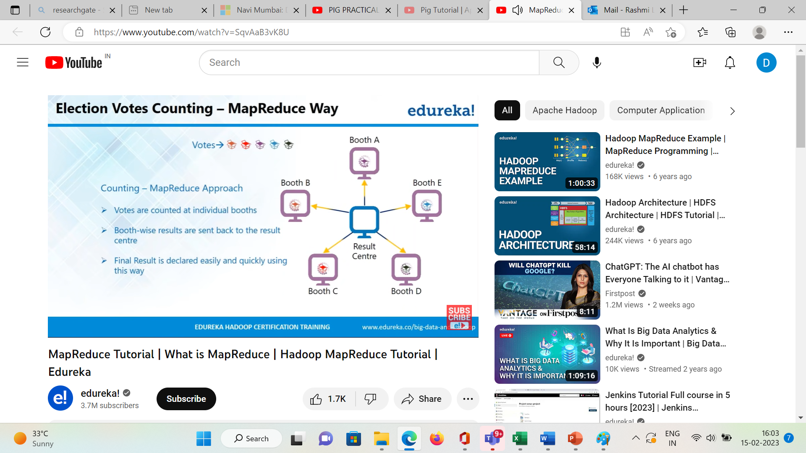
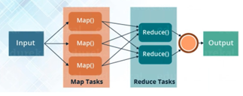
MapReduce Approach: Election Votes Counting
Counting Part of respective booth was done by map function and sent to reducer.
Combining of results was done by reducer function

Slide 26
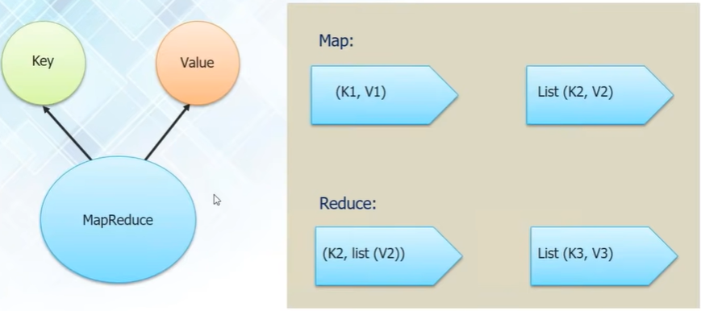
Anatomy of MapReduce:
Input
Output

Slide 27
Exercise: MapReduce
Search specific keyword in a file
Sort data by student name
Arrange the data on user ID, then within user ID sort them
in increasing order of page count
Write MapReduce program to find unit wise salary

Slide 28
hadoop namenode –format
hadoop secondarynamenode
hadoop namenode start-all.sh
hadoop datanode
hadoop dfsadmin -report
hadoop mradmin -refreshNodes
hdfs dfsadmin -setBalancerBandwidth <bandwidth>
hdfs fsck /user/example/data
hdfs fsck /path/to/hdfs/directory -files -blocks –locations
hdfs fsck /path/to/hdfs/directory -files -blocks -locations -racks –replicaDetails
hdfs fsck /path/to/hdfs/directory -files -blocks -locations -racks -replicaDetails > fsck_report.txt
-files -blocks -locations
hadoop secondarynamenode
How to Interact with HDFS

Slide 29
hadoop mradmin -refreshNodes -decommission <hostname>
hadoop mradmin -refreshNodes -commission <hostname>
hdfs dfs -ls /path/to/directory
hdfs dfs -copyToLocal /path/in/hdfs localfile
hdfs dfs -rm /path/to/file
hdfs dfs -rm -r /user/hadoop/data
hdfs dfs -mv /path/to/source /path/to/destination
hdfs dfs –put <src path> <dest path>
Hdfs –get <hdfs file path> <local path>
http://<TaskTracker-Hostname>:50060
http://<JobTracker-Hostname>:50030
hadoop balancer -h

Slide 30
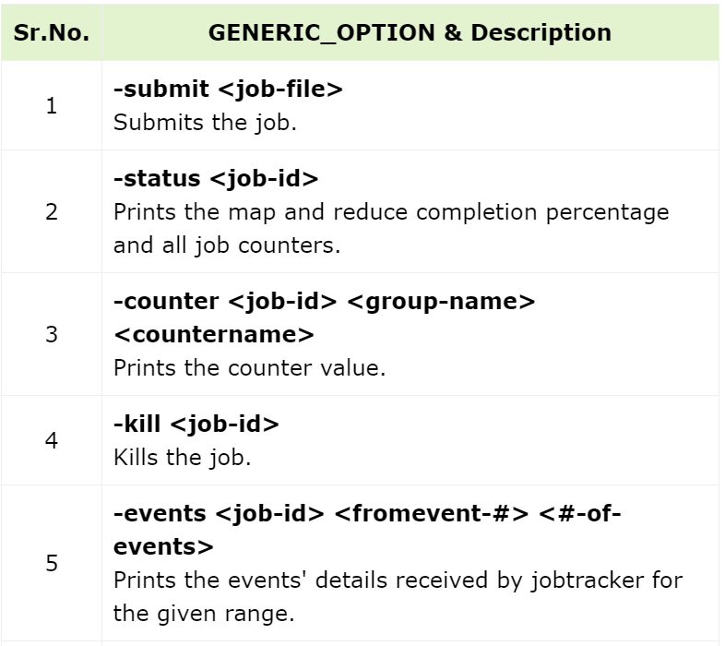
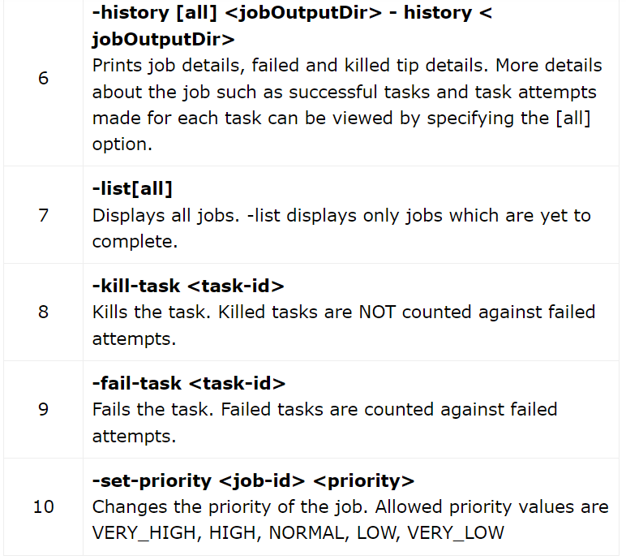
Interact with MapReduce Jobs

Slide 31
Yet Another Resource Negotiator (YARN)
YARN stands for “Yet Another Resource Negotiator“. It was introduced in Hadoop 2.0 to remove the bottleneck on Job Tracker which was present in Hadoop 1.0.
YARN was described as a “Redesigned Resource Manager” at the time of its launching
YARN architecture basically separates resource management layer from the processing layer.
YARN also allows different data processing engines like graph processing, interactive processing, stream processing as well as batch processing.
it can dynamically allocate various resources and schedule the application processing

Slide 32
YARN Features
Scalability: The scheduler in Resource manager of YARN architecture allows Hadoop to extend and manage thousands of nodes and clusters.
Compatibility: YARN supports the existing map-reduce applications without disruptions thus making it compatible with Hadoop 1.0 as well.
Cluster Utilization: Since YARN supports Dynamic utilization of cluster in Hadoop, which enables optimized Cluster Utilization.
Multi-tenancy: It allows multiple engine access thus giving organizations a benefit of multi-tenancy.

Slide 33
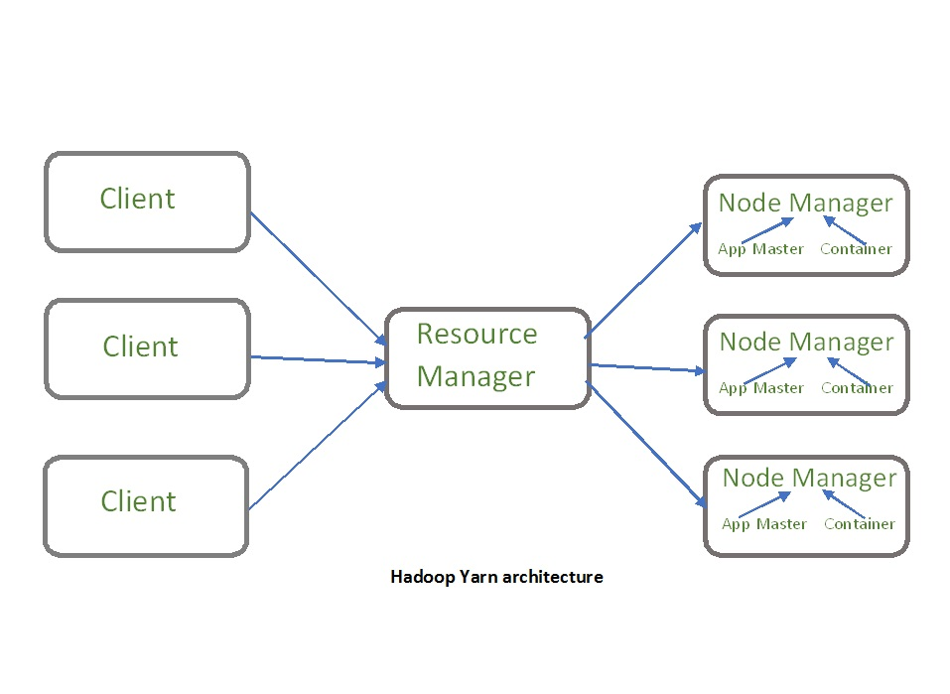
The main components of YARN architecture
Client
Resource Manager
1. Scheduler
2. Application manager
Node Manager
Application Master
Container

Slide 34
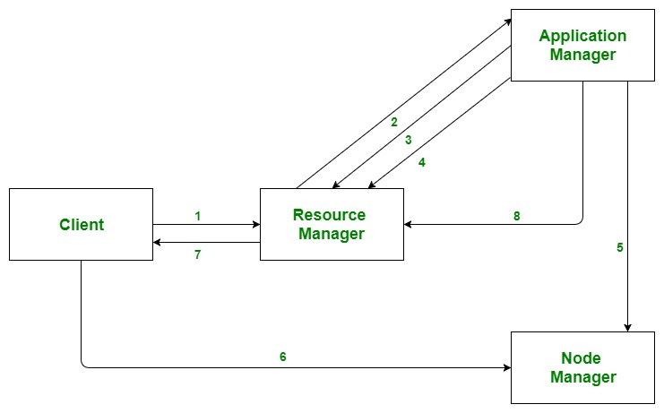
Application workflow in Hadoop YARN
Client submits an application
The Resource Manager allocates a container to start the Application Manager
The Application Manager registers itself with the Resource Manager
The Application Manager negotiates containers from the Resource Manager
The Application Manager notifies the Node Manager to launch containers
Application code is executed in the container
Client contacts Resource Manager/Application Manager to monitor application’s status
Once the processing is complete, the Application Manager un-registers with the Resource Manager

Slide 35
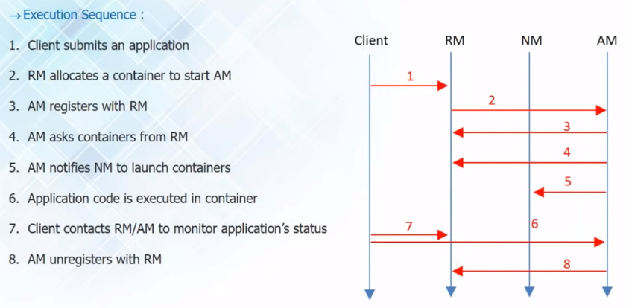
Application : Workflow

Slide 36
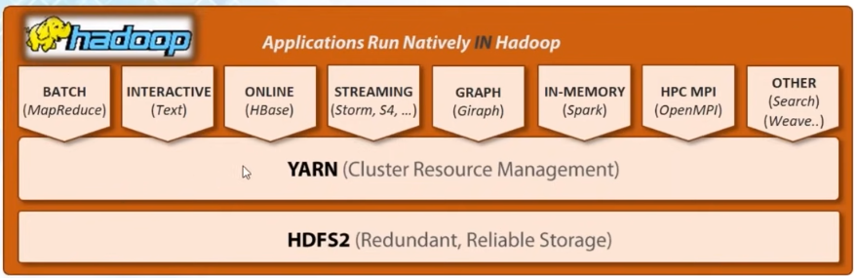
YARN : MapReduce Beyond
Using YARN lot of frameworks are able to utilize and connect to HDFS
YARN – Open gate for frameworks, other search engines and even
other big data applications also
Application of “HDFS ” increased because of YARN as resource provider

Slide 37
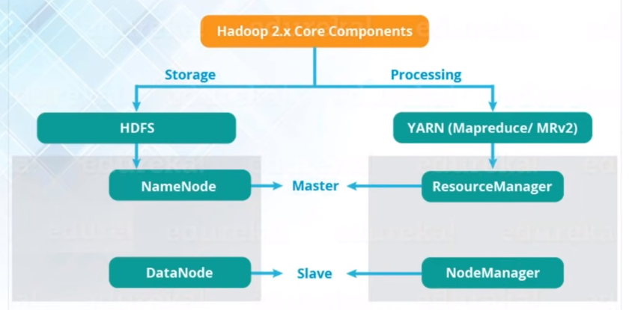
Hadoop Daemons:

Slide 38
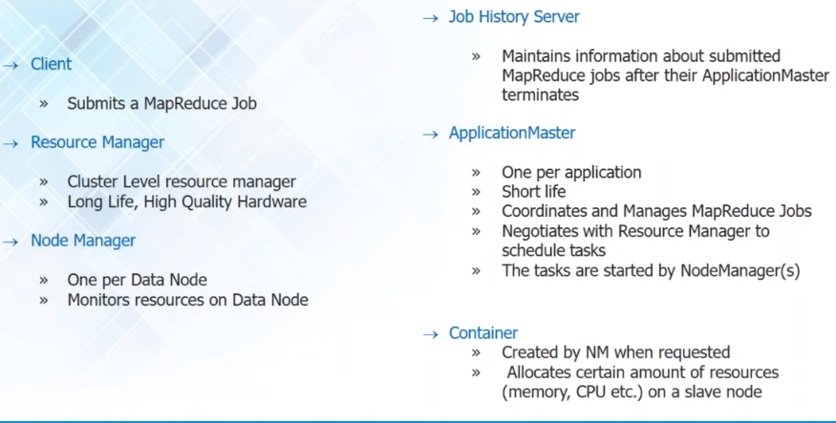
Hadoop 2.X MapReduce Yarn Components:

Slide 39
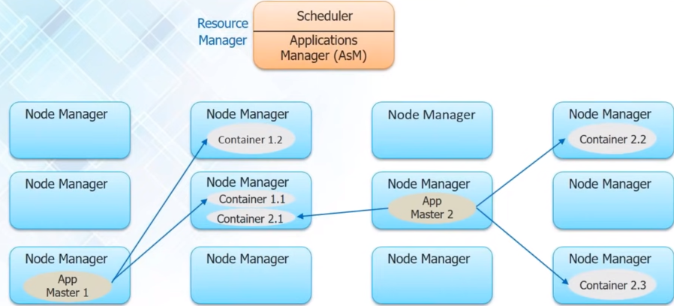
YARN: Workflow

Slide 40


